Slide 1
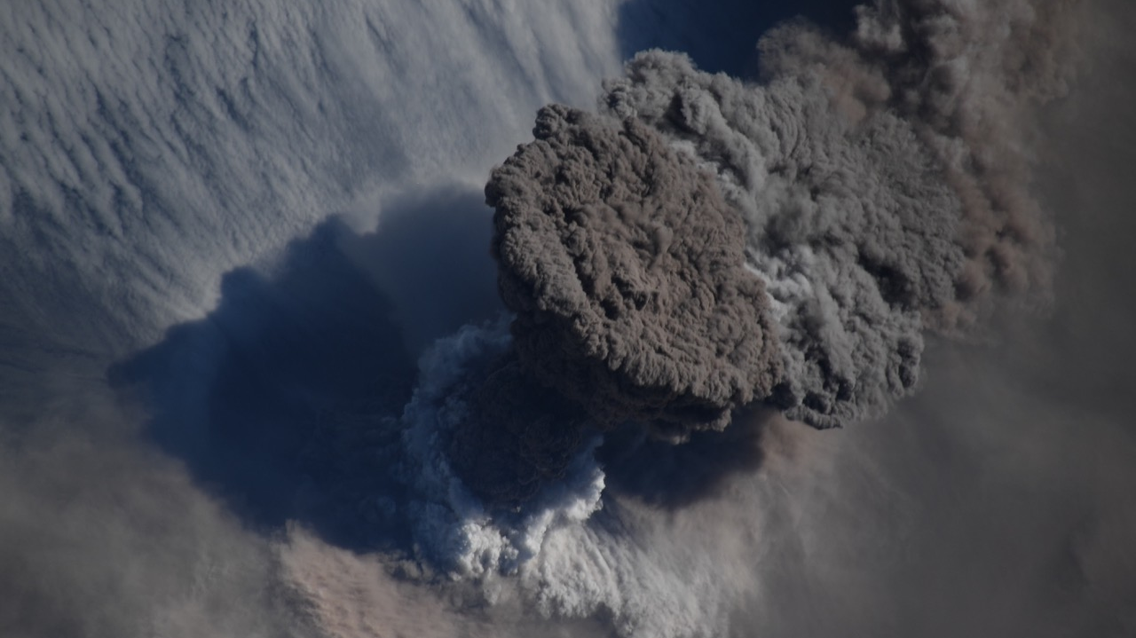
Volcanic clouds Hazards - What’s the risk?
Day-Night Monitoring of Volcanic SO₂ and Ash
for Aviation Avoidance at Northern Polar Latitudes
Volcanic eruptions inject sulfur dioxide (SO₂) and volcanic ash (VA) posing a substantial risk to aviation:
ingestion of silicate ash into jet engines.
As toxic SO₂ in-cabin air is compressed and pressurized, SO₂ levels may be concentrated and present risks
Present regulations dictate a zero ash tolerance policy for jet aircraft.
Uncertain ash location leads to unnecessary flight cancellations that have a ripple effect on the airline industry’s economy and personal travel
Raikoke volcano (Kuril islands)
erupted on June 22 2019
Injecting ash clouds at aircraft cruising altitudes 9-15km
Credit: International Space Station photo

Slide 2
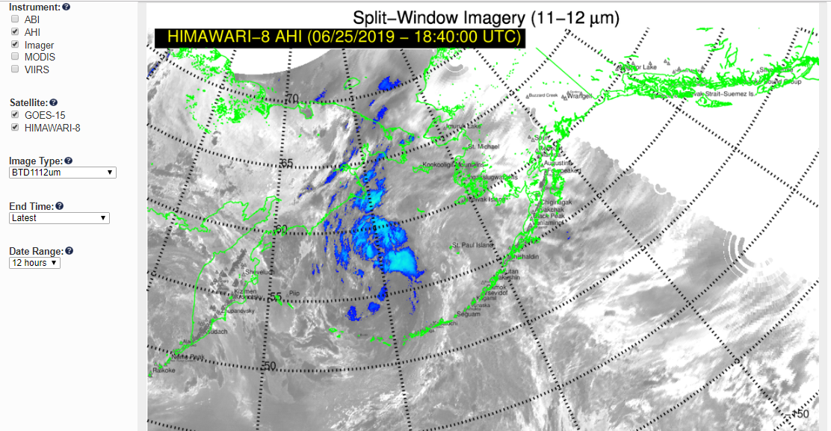
Volcanic Ash Advisory Centers (VAACs)
monitor volcanic clouds
Anchorage VAAC
VA advisory
06/25/2019
2200 UTC
In the wake of the June 22 Raikoke eruption parts of Alaskan Air Space
was Avoided by aviation
Notes:
Volcanic Ash (VA) Advisory Centers use satellite data to issue VA advisories to aviation stakeholders
Meteorological geostationary satellites have limited view of polar regions.
Volcanic SO₂ data are currently underutilized by VAACs.
We demonstrate local processing of volcanic SO₂ and ash data and expedited delivery to operational users:
USGS Alaska Volcano Observatory.
National Weather Service Alaska Aviation Weather Unit and Anchorage VAAC.
EUMETCast distribution service.
Perceived impact on VAACs operations:
Adding SO₂ polar imagery (day/night coverage, multiple orbits )
Reducing latency time < 30 minutes;
Convenient data formats (AWIPS);

Slide 3
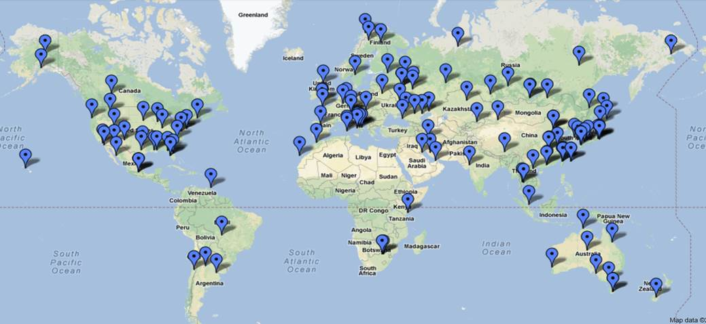
NASA Direct Readout Laboratory (DRL) develops IPOPP
Software and supports Real-Time Users and their Applications
GINA/UAF
Sodankyla (FMI)
DRL International Planetary Orbiter Processing Package (IPOPP) supports ~220 acquisition sites with ~3000 registered users from government, commercial, academia.
We developed IPOPP Apps for volcanic SO₂ and Ash Indices for Infrared VIIRS and UV Ozone Mapping Profiling Suite (OMPS) .
Detection products are tested at GINA (UAF) or FMI Ground Receiving Stations
DRL provides files ready to ingest into NASA web portal: https://maps.disasters.nasa.gov
https://directreadout.sci.gsfc.nasa.gov/
Raikoke SO₂ cloud on 21-23 June 2019
SO2
Volcanic SO₂ in Dobson Unit: 1 DU ~ 28.5 SO₂ kg km⁻²
~ 10 ppb in 1 km vertical layer at standard temperature and pressure

Slide 4
Low-latency VIIRS infrared SO₂ detection product
Frequent day-night coverage of high-latitude volcanoes from SNPP and NOAA-20 VIIRS
Fine Spatial Resolution: 750 m
Procedure (VIIRS-TIR) implemented at DRL
GeoTiff images ingested into NASA Disasters WWW portal
https://maps.disasters.nasa.gov
Will be implemented at GINA and FMI
Raikoke SO₂ cloud on 21-23 June 2019
Brightness Temperature Difference=BT@8.6μm – max BT
Notes:
Addressing critical need for night-time northern polar coverage, we are developing DR volcanic SO₂ products based on the thermal infrared (TIR) data acquired by the MODIS instruments aboard the NASA’s EOS Terra and Aqua platforms, and VIIRS instruments aboard the NASA/NOAA Suomi-NPP (SNPP) and NOAA20 polar orbiting operational weather satellites
SNPP/VIIRS data acquired on 22 and 23 June 2019
Combination provides frequent day-night coverage of high-latitude volcanoes
Fine Spatial Resolution: 1 km (nadir) for MODIS; 750 m for VIIRS
Example of low-latency SO₂ detection product: BT @ 8.6 μm channel – max BT over all channels
Procedure (VIIRS-TIR) has been implemented at DRL

Slide 5
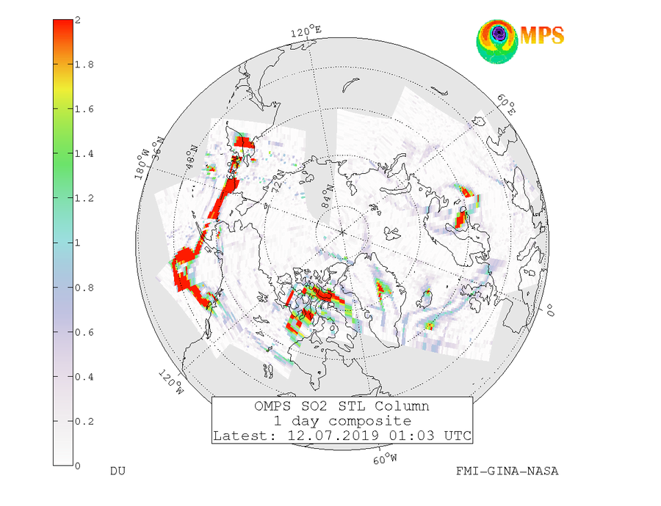
Data from Sodankylä reception as well as Alaska (received by GINA) are combined
SO₂ and aerosol data received in Sodankylä and Alaska DR stations re-disseminated via EUMETCast
The same data sent also to SACS system (The Support to Aviation Control Service)
Data available from FTP service (downloaded by NASA, KNMI and NOAA)
Images available via http://sampo.fmi.fi/so2_comp.html
Plans:
NOAA-20 OMPS implementation
Adding day/night VIIRS TIR SO₂ data
GINA (UAF)
Sodankyla (FMI)
Volcanic Sulfur Dioxide [Dobson Units]
Notes:
Aura/OMI (since 2010) and SNPP/OMPS (since 2014) Direct Readout (DR) volcanic SO₂ and UV ash Index (AI) data have been used by Finnish Meteorological Institute (FMI) Very Fast Delivery Volcanic service ~20 minutes
NASA-NOAA SNPP/OMPS DR data are now received and processed by UAF-GINA in Alaska. DR data used by European SACS and USGS Alaska Volcano Observatory.
In 2017 FMI started using OMPS DR data from GINA/UAF and since 2019 provides data to the EUMETCast distribution service
Objective 2: Enabled NASA’s Direct Readout (DR) volcanic data in Partner’s Decision-Making
The NASA’s EOS-Aura and S-NPP satellites have Direct Broadcast (DB) capability, i.e. the ability to broadcast data at the same time as it is measured. This possibility is utilized in the FMI’s Very Fast Delivery (VFD) Service for monitoring atmospheric composition in almost real time, within 20 minutes after the overpass. The service started in 2006 processing Aura OMI surface UV and ozone data. After the eruption of the Eyjafjallajökul the system was updated in 2010-11 with volcanic ash and VSO2 data. During Y1 our team provided software for processing DR OMPS volcanic data. Currently both OMI and OMPS DR data are processed at Sodankyla (Fig.). The VFD covers Northern Europe, Russia and Arctic Ocean, but the coverage is restricted by the fact that the satellite has to be visible from the Sodankylä ground station in northern Finland.
Through the established partnership between GINA, NASA GSFC Direct Readout Laboratory (DRL) and SNPP’s Ozone SIPS in Y2 we started processing DR OMPS data from GINA ground station in Fairbanks, Alaska. UAF-GINA has provided access to direct broadcast SNPP data in raw format, maintained hardware to run the International Polar Orbiting Processing Package (IPOPP), maintained IPOPP and the Ozone Mapping and Profiling Suite (OMPS) Science Processing Algorithm (SPA), and provided NASA Direct Readout Labs (DRL) with products produced by IPOPP and the OMPS SPA. In Y2 an updated version of the IPOPP OMPS SPA processor software was installed. Data and products have been provided to NASA DRL and have been used to generate analyses of events. In May 2016 GINA started capturing DR data from Aura OMI passes on a new Orbital Systems 3-meter antenna. The data are transferred to FMI for processing and imagery generation.
In Y3 (2017) updated OMPS SO2/AI Science Processing Algorithm (SPA) OMSNadir (v2.1) has been delivered to DRL, tested, proven operational and distributed to user community for operational processing. Extensive development was necessary for the OMSNadir prototype version (v2.0) since it also included alignment with the unique ACPS data formats defined to enhance scientific use and long-term record continuity. This approach insured NASA DR data are in sync with NASA’s scientific processing environment at ACPS. DRL continues working closely with GSFC’s Ozone SIPS to integrate updated OMSNadir (v2) SPA into NASA’s International Polar-Orbiter Processing Package (IPOPP) and to obtain feedback from collaborators at FMI and co-Is at GINA/UAF, as well as additional international collaborators. The new OMSNadir (v2.1) SPA improved measurement quality, as well as added features for the higher resolution processing when these data are made available in the downlink from the SNPP and JPSS-1 platforms. The SPA will be maintained by DRL and Ozone SIPS and updated when necessary as defined by user needs.

